Slide 1
Relational working
LEARNING FROM THE 2023-2024 PEER LEARNING PROGRAMME

Slide 2
Programme Objectives
Enable organisations to identify practical steps to work more relationally.
Provide case studies, perspectives and frameworks to help organisations reflect on their own practice.
Offer a community of peers to support learning about what’s working well in terms of relational practice and to share inspiration and support.
Develop a package of resources to be shared more widely.

Slide 3
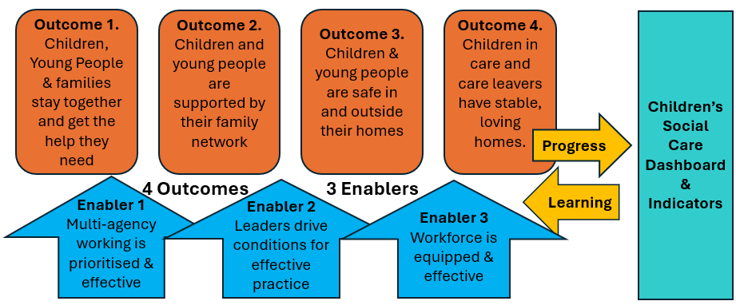
Programme CONTEXT
Independent Review of Children’s Social Care: “No young person should leave care without at least two loving relationships, by 2027.”
Standalone Ofsted Judgement: “Care leavers are supported to maintain relationships with people who are important to them…”
Children’s Social Care National Framework

Slide 4
Programme participants & process
Twelve Local Authorities, Three VCS organisations
Six half-day online sessions between February 2023 and February 2024
Each participant asked to identify a specific project to work on – e.g. building relationships between young parents or developing a Lifelong Links service.
Each session included some input, some time for discussion in breakout groups, and time for action planning.

Slide 5
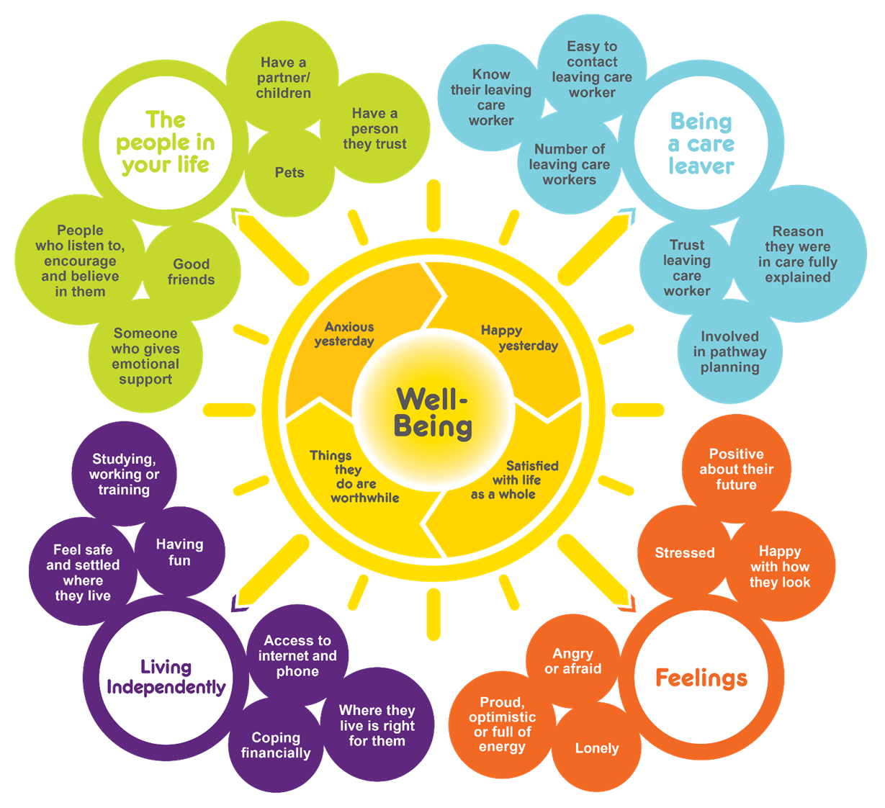
Inputs: young people’s views
Learning from the Coram Bright Spots Survey
For all young people having good friends and trusting and supportive relationships were really important. This included trusted carers and social workers. How can transition plans see young people as relational beings and prioritise the relationships that matter to them?
Discussion: Should we be focusing on interdependence, rather than independence?
Learning from a young person’s story
He’d been in prison and thought no-one cared. His PA was his only connection to the outside world. They wrote regularly, found his interests, and sent photos and information about them.
His PA sent him a birthday card – the only one he received. He said he would never be able to explain how much the sound of that card being pushed through the door meant to him.

Slide 6
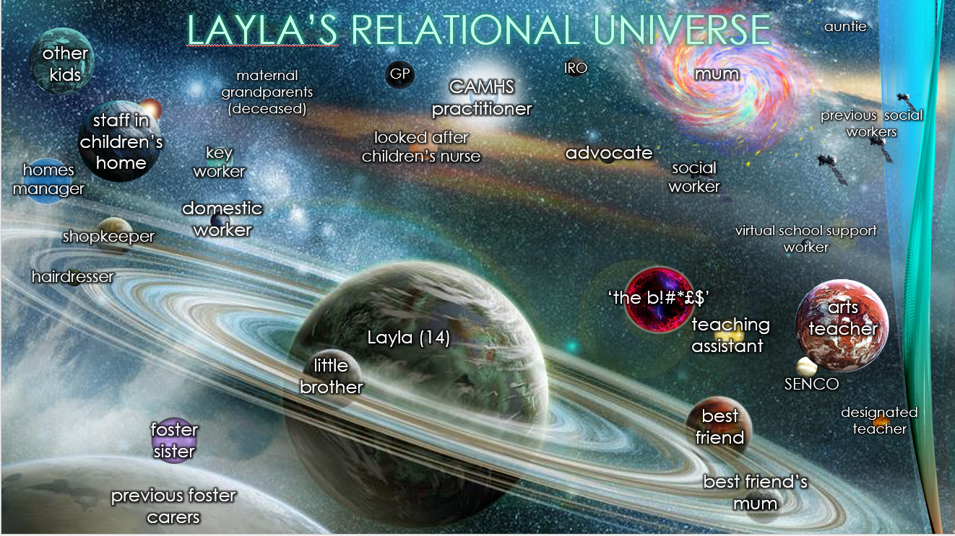
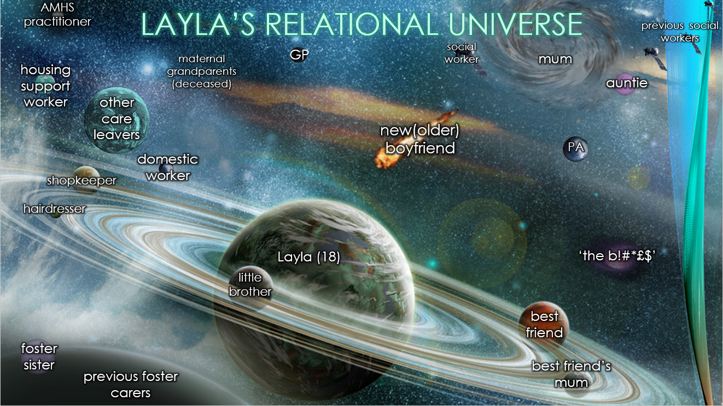
inputs: frameworks
The Relational Universe
The Relational Universe visualises who is in our lives and how they are connected. The constellation can help us better understand different relationships, recognise that we’re all interdependent, and explore how we can strengthen relationships.
A framework for thinking: the 3Ps model
The 3 Ps model is a way to think about the professional, personal and private self.
Building authentic relationships with young people is critical to the work, because they need to know they can trust their worker. The 3Ps model helps us understand that we can’t be professional without being personal, so we have to be both.
We should avoid sharing the private self – those parts of us that should rightly remain private.
Notes:
Values collection via StreamAlive (3 minutes)
Breakout room (7 minutes)
Plenary discussion (10 minutes)
Key points to draw out:
We need to place our values at the heart of practice and have a shared understanding of what these are and how we enact them
We may have similar values but divergent experiences of how these are brought to life in the relationships we build, e.g. we may have very different understandings of what ‘respect’ looks and feels like
We need to value relationships as precious in themselves, not instrumentalise or reduce them to a means to an end
These values shine through from the very first moment we engage with someone, no matter how long for (Maya Angelou quote)

Slide 7
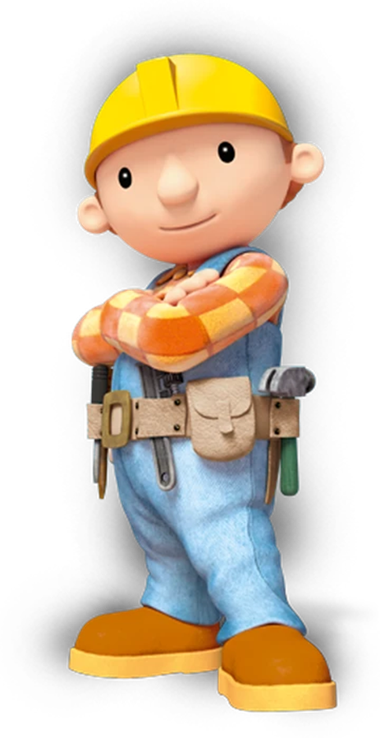
inputs: case studies
Input: Camden’s Relational Activism Approach
This has focused on building a system based on love. It encouraged us that it is possible to develop a way of working in children’s social care that is more relational and human.
Input: Ways of thinking about assessing progress
The Coram Voice Bright Spots survey asks about subjective wellbeing, including trusting supportive relationships, feelings of loneliness, and good friends. Blue Cabin were working with tialt.org on creative ways of assessing their impact, such as playlists, postcards, and artwork.
Input: The Most Significant Change Approach
The Developing Evidence-Enriched Practice (DEEP) project draws on “Most Significant Change” methods. It asks people to tell stories about their experiences and encourages professionals to reflect together on what they’ve heard. It deliberately seeks out different perspectives.

Slide 8
Project Example: Reflections from Bradford
Participant’s Goal | Reducing criminalisation of Bradford’s children in care and care leavers through improved relationship-based practice and trauma informed approaches between Leaving Care and Police colleagues
Progress Made | We have strengthened links relationships and links between the agencies involved. We have gained a better understanding of the number of care leavers involved with the YJS and probation. We launched a “10 point plan” within the leaving care service and placement providers. We have developed local safety planning processes where plans are co-produced with young people (18+) and the whole system/team around them.
Young people’s views on impact | We have devised a participation questionnaire and we will be obtaining young people’s views. It is unclear what difference this work has made and so we hope to use this to get their views.
Professionals’ learning | When we started, it was felt the plan was too broad, and so we narrowed to critical points and built on the plan. Having progressed through the plan there is much more work to do, and we can progress other areas such as delivering training with partners.

Slide 9
Project Example: Reflections from Bradford (2)
Enablers for progress | It was helpful to narrow the plan from its original broad focus. There was a commitment to working together, and to share ideas. The LA, Probation and YJS have had consistent attendance. We drew on support from the police and placement coordination team to deliver the 10 point plan to understand the impact of criminalising our young people.
Barriers to progress | Staff movement – the police lead who was working on the project moved roles and we have not had police contribution since September 2023. Changes in service managers have also hampered getting sign-off for new ways of working. We feel we need to do more work to hear young people’s views. Time constraints have been an issue for all agencies.
Contribution of the Peer Learning Programme | The peer learning programme project has increased participation among agencies and provided knowledge of services to prevent criminality.
Notes and Quotes | “The programme has strengthened relationships between those involved and has opened up discussions for ongoing and future working together. ”

Slide 10
Progress Made
Built professional relationships – across different agencies, with LAs that refer young people to our VCS project, with others in our own organisation. Eg Bradford Council with WY police, Leicestershire Cares with LCC, Stockport Lifelong Links service with IROs & PAs.
Worked more closely with colleagues to support young people better - shared training, ideas and tools to help us understand each other’s perspectives. Eg House Project and Lancashire Council sharing ideas, Blue Cabin doing joint training, Devon working with accommodation providers.
Supported young people better - reached young people to offer them support in building relationships with each other, and with people who mean something to them. E.g. H&F started taking Lifelong Links Referrals, Wandsworth Eid celebration for former UASC care leavers, Leicestershire Cares seaside trip for young parents.

Slide 11
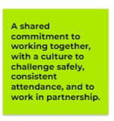
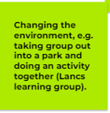
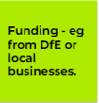
What enabled our work?
A shared commitment to working together. E.g. NHP & LCC said “the culture allowed colleagues to bring challenges, and to challenge safely.” Bradford said, “There was a commitment to working together, and to share ideas.”
Changing the working environment. E.g. Leicestershire Cares said that going on a day-trip with young people enabled them to bond better than at the sessions in the centre.
A defined project focus – narrowing it from being too broad
Senior Manager Support – giving permission to participants to take time out from the day-to-day.
Positive feedback from young people. E.g. from the young people who took part in the arts activities in Deerbolt Prison with Blue Cabin, and the young people who worked with the Lifelong Links team in Stockport.
Funding – DfE funding for Lifelong Links projects and from local businesses in Leicestershire.

Slide 12
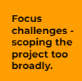
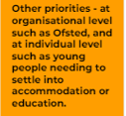
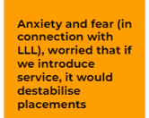
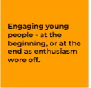
What barriers did we face?
Staffing, Staffing, Staffing. All the LA projects said that internal staffing changes were a barrier. E.g in Bradford the police lead moved roles and wasn’t replaced. In Stockport churn of social workers hampered sharing of information about Lifelong Links. In Devon the project lead was asked to cover two services.
Time and resource constraints. E.g. The Telford & Wrekin Lifelong Links project wasn’t funded by DfE and the plans were dropped. In Leicestershire there was only funding for bi-monthly young people’s group meetings.
Focus challenges. E.g. The House Project / Lancashire team found that their project wasn’t very tangible and had to rescope.
Engaging young people. Some projects felt they needed to do more work to hear young people’s views on what issues to prioritise or that it took time to engage young people in new groups.
Colleagues’ concerns. Anxiety that connecting with birth family members or previous carers through Lifelong Links would destabilise current placements.

Slide 13
Key learning points: seven reflections from the programme
Working relationally with colleagues enables us to support young people better. The Relational Universe helped us see how our roles fitted together with the other people in their lives.
The concept of “interdependence”, rather than independence, is helpful for how we want our young people to thrive in future and feel they belong where they live.
We shouldn’t be frightened of using the word “love” in our work. The 3Ps helped us think about our Professional, Personal, and Private selves, what we share to enable human connection, and what we keep private.
We heard from young people that reliability and consistency are the key qualities in relationships with professionals. We challenged ourselves to see relationships as an end in themselves, not a means to an end.
Subjective wellbeing surveys and “Most Significant Change” approaches are ways to hear what young people, and professionals, say are important to them.
Starting with a small, focused, project is better than tackling everything at once!
Even when we don’t have much time, remember – relational practice “ain’t what we do, it’s the way that we do it!”

Slide 14
Sources & references
More detail on the Relational Practice Peer Learning programme, links to all the resources etc are at https://leavingcare.org/relational-practice-resources/
Young People’s views – the Coram Voice Bright Spots Survey https://coramvoice.org.uk/for-professionals/bright-spots-programme/
Frameworks:
The Relational Universe https://www.thempra.org.uk/social-pedagogy/key-concepts-in-social-pedagogy/relational-universe/
The 3Ps https://www.thempra.org.uk/social-pedagogy/key-concepts-in-social-pedagogy/the-3-ps/
Case Studies:
The Relational Activism approach used in Camden Council https://www.relationalactivism.com/
Assessing progress relationally with tialt.org https://www.tialt.org/
The DEEP Project/Most Significant Change https://www.deepcymru.org/en/ and https://www.betterevaluation.org/methods-approaches/approaches/most-significant-change. For an example of using Most Significant Change with care leavers, see https://esmeefairbairn.org.uk/latest-news/using-most-significant-change-understand-outcomes-young-people-leaving-care/

Slide 15
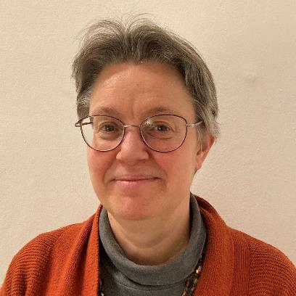
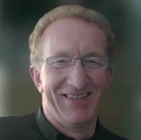
Contacts of the delivery team
Janet Grauberg
Esmée Fairbairn Leaving Care Learning Programme
j.grauberg@googlemail.com
Darren Bishton
National Leaving Care Benchmarking Forum
darren.bishton@catch-22.org.uk
Gabriel Eichsteller
ThemPra Social Pedagogy CIC
gabriel@thempra.org.uk

Slide 16
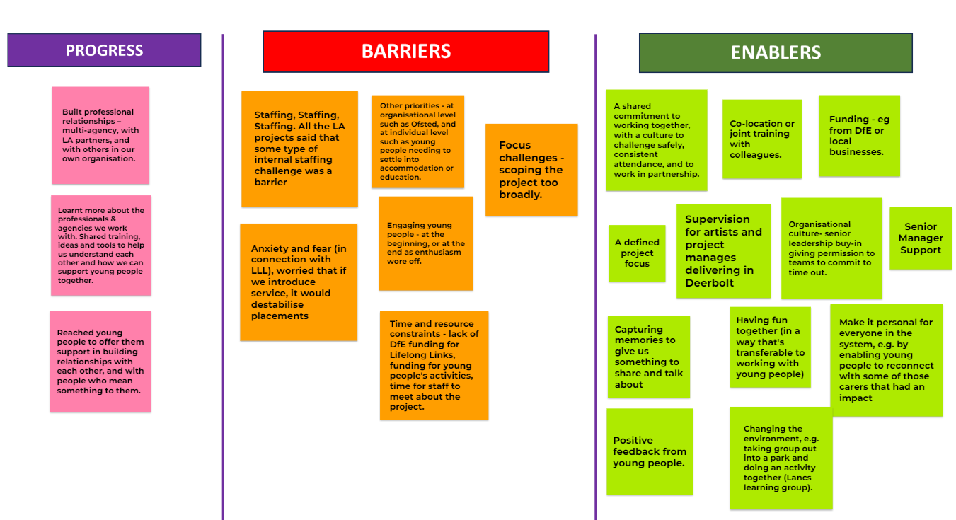

Slide 18
